Slide 1

INFO 5100
Application Engineer
Campus Marketplace
Second-Hand Trading Platform
Team: Group 17
1:Ziao He,002539722；
2:Yujie Liang, 002085359
3:Yiyang Lin,002565394；
4:Liyun Li,002593949
Key Focus: End-to-End Trading Workflow
&
Role-Based Management

Slide 2
1
Problem Statement
College students often exchange second-hand textbooks, small furniture and electronic products.
It is very difficult to effectively search for products, compare prices or verify the reliability of the other party.
There is no campus-specific platform that supports the entire transaction process (listing, searching, communication, booking, completion) and has basic security and monitoring.
Therefore, students waste time, miss good opportunities and feel uncertain - this clearly indicates the need for a dedicated campus market.

Slide 3
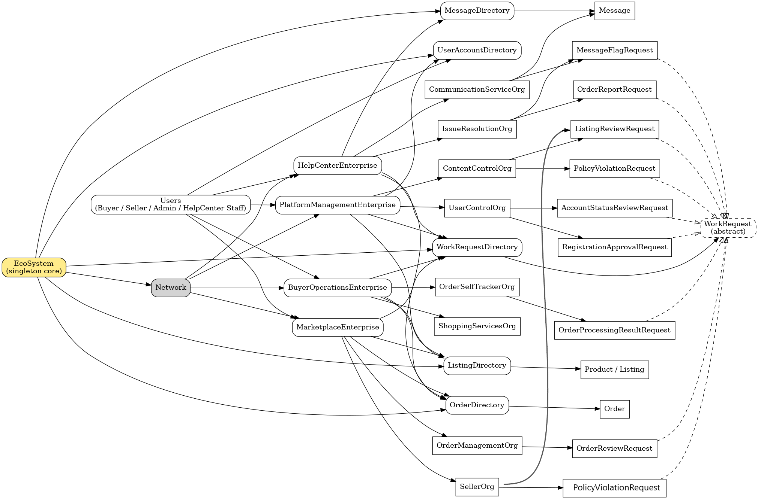
2
UML Class Diagram

Slide 4
3
Advanced feature introduction
Buyer-side Features
✅The two roles can switch with each other
✅Communicate with the seller
✅Track Order
Seller-side Features
✅Track and manage orders until completion
✅Communicate with the buyer
Platform-side Features
✅Senior administrators can see everyone's Workrequest
✅Trace each work request to see who submitted it.
Helpcenter-side Features
✅Monitor communication between the seller and buyer and handle communication issues

Slide 5
3
advanced feature introduction
🚀Future Improvements
⚙️ Account registration
➕ WorkrequestDao applicable storage management
📊Profit calculation
📦Integrating the logistics system for better monitoring of the Order status at different stages
🧠Recommendation algorithm to provide sellers with suitable price ranges for their products and buyers' shopping carts

Slide 6
THE END

